Slide 1
A ONE STOP SOLUTION FOCUSING ON TOURISM
CSE7101- Capstone Project
Review-2
Batch Number: CSE_274
Under the Supervision of,
Mr. Asad Mohammed Khan
Professor / Associate Professor / Assistant Professor
School of Computer Science and Engineering
Presidency University
Roll number | Student Name
20231CSE3047 | KARTHIK
20231CSE3025 | H N HEMANTH
20231CSE3021 | HARSHA S K
Name of the Program: B .Tech Computer Science & Engineering
Name of the HoD: Dr. Asif Mohammed and Dr. Blessed prince
Name of the Program Project Coordinator: Dr. Jayavadivel Ravi
Name of the School Project Coordinators: Dr. Sampath A K , Dr. Geetha A

Slide 2
Content
01. Problem & Objectives
02. System Architecture
03. Benefit’s
04. Future work

Slide 3
Problem Statement
The tourism industry is evolving rapidly, with travelers seeking easy access to all aspects of their journeys—from planning to booking and exploring. A One-Stop Solution for Tourism aims to provide a comprehensive platform that brings together various tourism-related services into a single system.

Slide 4
OBJECTIVES
The aim of the One-Stop Solution for Tourism project is to develop a comprehensive platform that integrates all essential travel services—such as accommodation, transportation, activities, and dining—into a single, user-friendly interface.
The primary objectives are:
User-Friendly Interface: Provide a platform where users can plan, book, and manage their trips effortlessly.
Integrated Services: Combine transportation, accommodation, tourist attractions, and dining services under one roof.
Real-Time Recommendations: Utilize AI to offer personalized suggestions based on user preferences and behavior.
Smart Payments: Enable secure, multi-currency payment gateways to support global travelers.
Vendor Collaboration: Facilitate partnerships with hotels, airlines, tour operators, and other travel service providers.

Slide 5
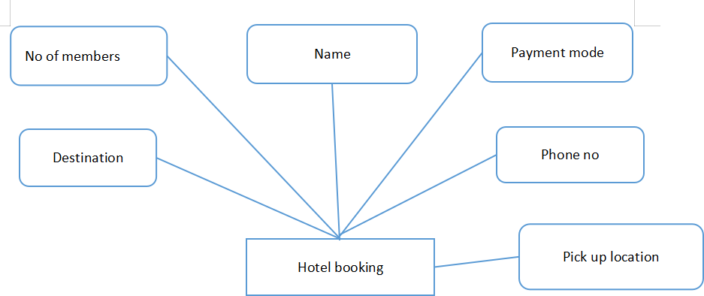
System Architecture Overview
Diagram:

Slide 6
Benefit's
For Tourists: Seamless trip planning, cost efficiency, personalized experiences.
For Businesses: Increased visibility and direct engagement with tourists.
For Tourism Boards: Real-time analytics for policy and planning.

Slide 7
Future Work
Incorporation of Augmented Reality (AR) for immersive cultural experiences.
Blockchain for secure, transparent transactions.
Expansion to support sustainable and eco-tourism initiatives.

Slide 8
Github Link
GitHub Link:-
https://github.com/sidduhemanth/Capstone-project-travel-and-tourism

Slide 9
References (IEEE Paper format)
[1]. A. Maheshwari and A. K. Sahoo, "Travel Buddy- One Stop Solution for Planning," INTERNATIONAL JOURNAL OF ENGINEERING RESEARCH & TECHNOLOGY (IJERT), vol. 13, no. 05, May 2024.
[2]. Y. Zhang, L. Jiao, Z. Yu and Z. L. a. M. Gan, "A Tourism Route-Planning Approach Based on Comprehensive Attractiveness," IEEE Access, vol. 8, pp. 39536-39547, 2020.
[3]. Chauhan, A. a. Gupta and R. a. Singh, "Trip-A Complete Tourism Solution," Proceedings of the Advancement in Electronics & Communication Engineering, 2022.
[4]. X. Y. Zheng, B. T. Han and a. Z. Ni, Tourism route recommendation based on a multi-objective evolutionary algorithm using two-stage decomposition and Pareto layering, vol. 10, 2023., p. 486–500.
[5]. A. Mandic, Z. Mrnjavac and L. Kordić, TOURISM INFRASTRUCTURE, RECREATIONAL FACILITIES AND TOURISM DEVELOPMENT, vol. 24, 2018.
[6]. Margarita Boiko (Ukraine), M. B. (2017). DEVELOPMENT OF THE TOURISM CLUSTER (Vol. 14).
[7]. WALLACE, M., MAGLOGIANNIS, I., & KARPOUZIS, K. (2003). INTELLIGENT ONE-STOP-SHOP TRAVEL RECOMMENDATIONS USING AN ADAPTIVE NEURAL NETWORK AND CLUSTERING OF HISTORY (Vol. 6).

Slide 10


